Slide 1
Parallel Vector Multiplication using OpenMP
PARALLEL COMPUTING LABORATORY PROJECT
Sequential vs Shared-Memory Parallel Execution
C[i] = A[i] × B[i]
Shrikar
Shreya
Sai Shree Ram
Ankush
01FE24BCI013
01FE24BCI033
01FE24BCI034
01FE24BCI096
Problem Definition → Sequential → Parallel Design → Implementation → Runs → Results → Graphs → Analysis → Demo

Slide 2
Problem Definition
Task
Vector A × Vector B → Vector C
Element-wise multiplication of two vectors
Sequential: one element at a time
Each multiplication is independent
Hence suitable for parallelization
Goal: compare sequential vs OpenMP
Vector A
→
Vector B
→
Vector C
C[i] = A[i] × B[i]
[ a0 a1 a2 … ] × [ b0 b1 b2 … ] → [ c0 c1 c2 … ]
Takeaway: independent element products make this problem parallel-friendly.
2/12

Slide 3
Sequential Algorithm
Steps
Create vectors A, B and C
Initialize A and B
Iterate i = 0 to N−1
Compute C[i] = A[i] × B[i]
Measure execution time
Pseudocode
FOR i = 0 to N-1
C[i] = A[i] × B[i]
END FOR
Implementation
src/vector_sequential.cpp
Takeaway: a single loop over N elements is the baseline for all comparisons.
3/12

Slide 4
Parallel Design using OpenMP
Independent
Distributed
Configurable
Every iteration is independent
OpenMP spreads iterations across threads
Thread count is a command-line argument
Parallel (OpenMP)
Sequential
#pragma omp parallel for
for (i = 0; i < N; i++)
for (i = 0; i < N; i++)
C[i] = A[i] * B[i];
C[i] = A[i] * B[i];
Takeaway: one pragma turns the sequential loop into a parallel loop.
4/12

Slide 5
Working Parallel Implementation
Input vectors
OpenMP parallel loop
Multiple threads
Output vector
→
→
→
C++
GCC / G++
OpenMP
#pragma omp parallel for
Run with N and thread count
./vector_openmp 1000000 1
./vector_openmp 1000000 4
./vector_openmp 1000000 8
./vector_openmp 1000000 12
Takeaway: the same program runs with 1, 4, 8 or 12 threads from the command line.
5/12

Slide 6
Experimental Setup
Vector sizes
Thread counts
Hardware & tools
100,000
1,000,000
5,000,000
10,000,000
1
2
4
8
12
13th Gen Intel Core i5-13420H
12 logical CPUs
Ubuntu / WSL, G++, OpenMP
Python, Matplotlib
Each configuration is executed multiple times; the average execution time is recorded.
Takeaway: 4 sizes × 5 thread counts = 20 benchmarked configurations.
6/12

Slide 7
Performance Metrics
Execution Time
Speedup
Efficiency
Time to complete the vector multiplication.
Sequential Time / Parallel Time
Speedup / Threads × 100
Lower is better
Example
Sequential = 0.020 s Parallel = 0.010 s → Speedup = 2×
Takeaway: speedup shows the gain; efficiency shows how well threads are used.
7/12

Slide 8
Experimental Results
Vector Size | Threads | Time (s) | Speedup | Efficiency
100,000 | 1 | 0.000011 | 1.37105× | 137.05%
100,000 | 2 | 0.000068 | 2.75416× | 122.81%
100,000 | 4 | 0.000027 | 5.92244× | 148.06%
100,000 | 8 | 0.000031 | 5.24383× | 65.55%
100,000 | 12 | 0.000860 | 0.18804× | 1.57%
1,000,000 | 1 | 0.002643 | 0.81163× | 81.16%
1,000,000 | 2 | 0.002548 | 0.84208× | 42.10%
1,000,000 | 4 | 0.002571 | 0.83415× | 20.85%
1,000,000 | 8 | 0.002534 | 0.84658× | 10.58%
1,000,000 | 12 | 0.007561 | 0.28373× | 2.36%
Vector Size | Threads | Time (s) | Speedup | Efficiency
5,000,000 | 1 | 0.010359 | 1.94860× | 194.86%
5,000,000 | 2 | 0.012551 | 1.60830× | 80.41%
5,000,000 | 4 | 0.010829 | 1.86398× | 46.60%
5,000,000 | 8 | 0.011644 | 1.73352× | 21.67%
5,000,000 | 12 | 0.008441 | 2.39125× | 19.93%
10,000,000 | 1 | 0.029905 | 0.95865× | 95.87%
10,000,000 | 2 | 0.028320 | 1.01230× | 50.62%
10,000,000 | 4 | 0.022255 | 1.28817× | 32.20%
10,000,000 | 8 | 0.017534 | 1.63498× | 20.44%
10,000,000 | 12 | 0.022668 | 1.26471× | 10.54%
Efficiency above 100% (amber) is reported exactly as measured. Extremely small workloads, timing noise and measurement overhead can produce such anomalous values.
Takeaway: results are measured values; anomalies come from tiny workloads and timing noise.
8/12

Slide 9
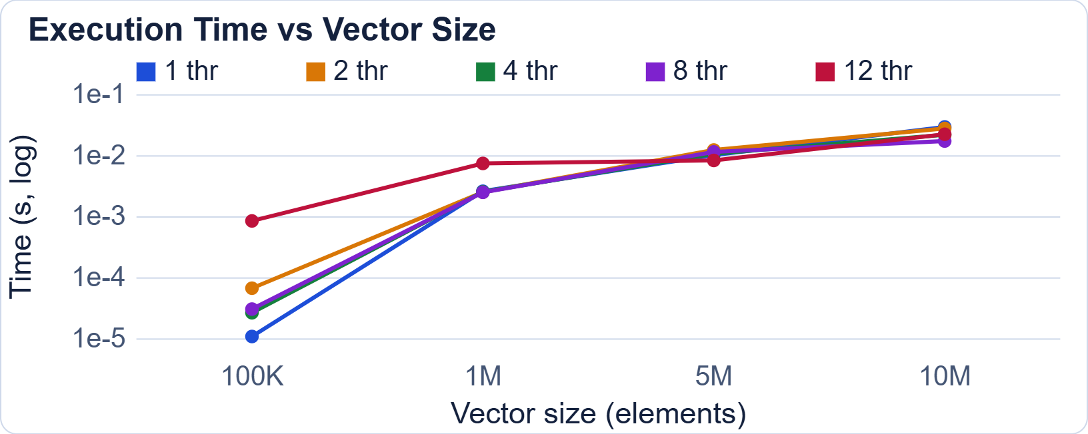
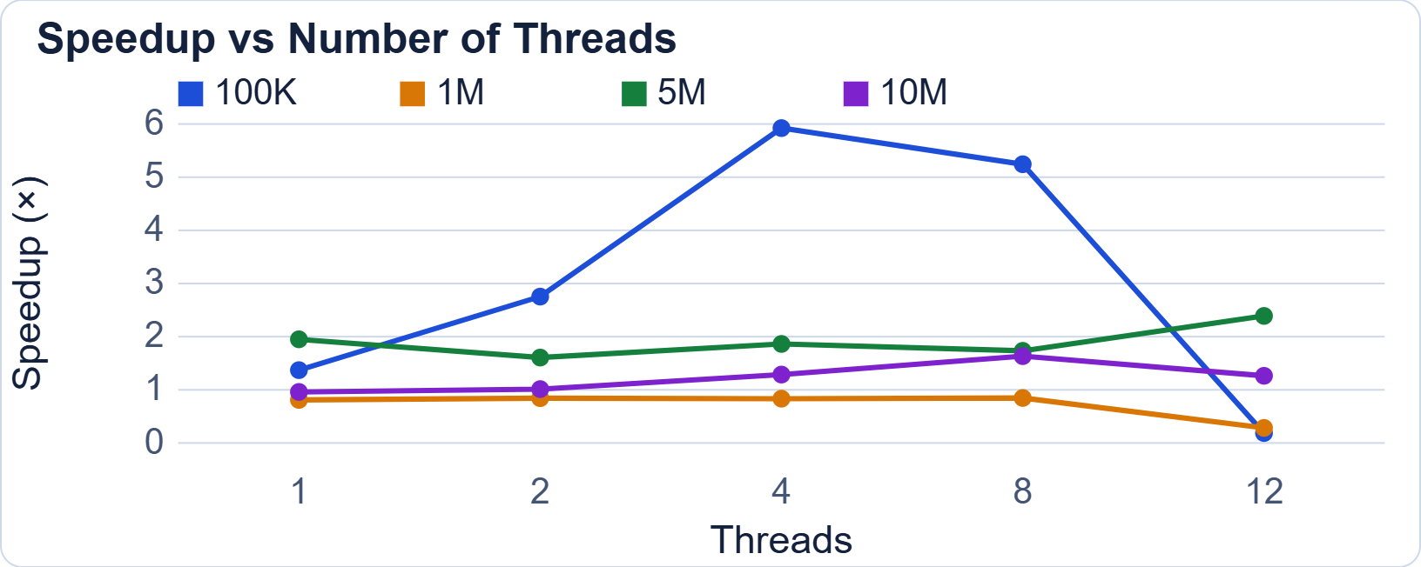
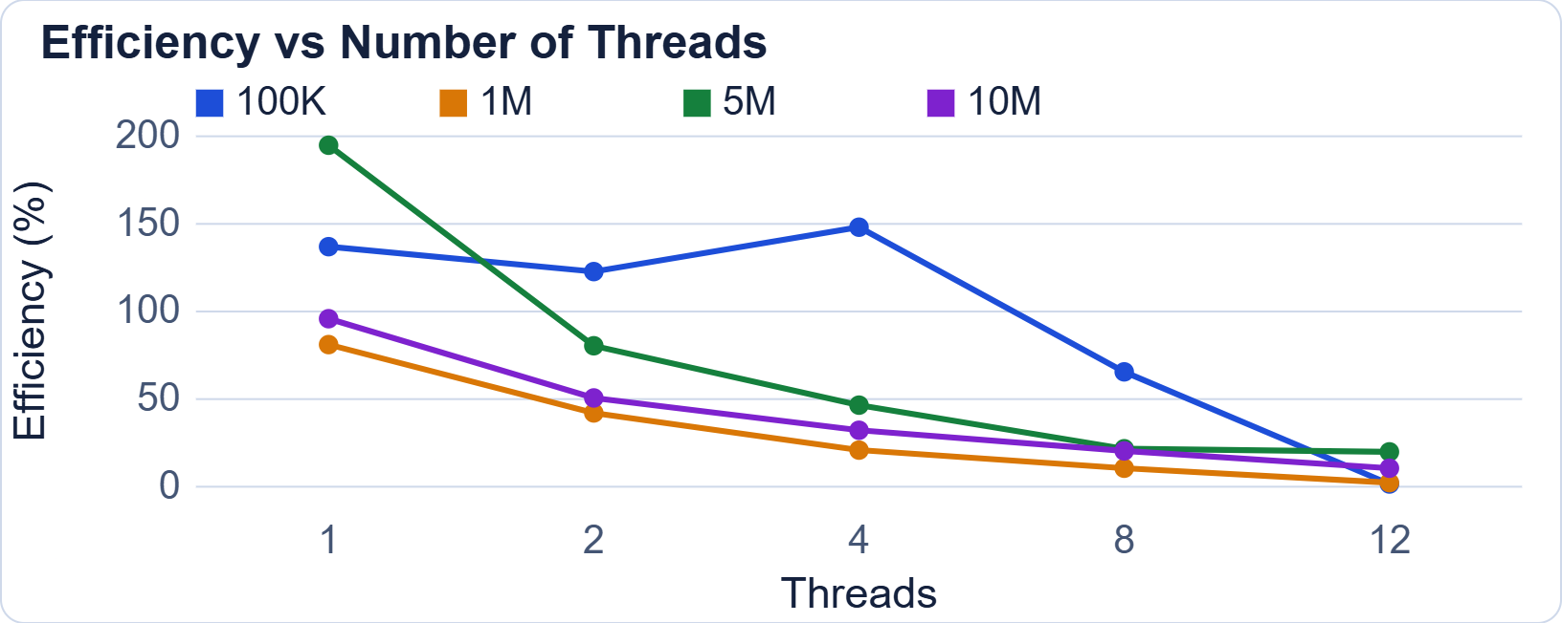
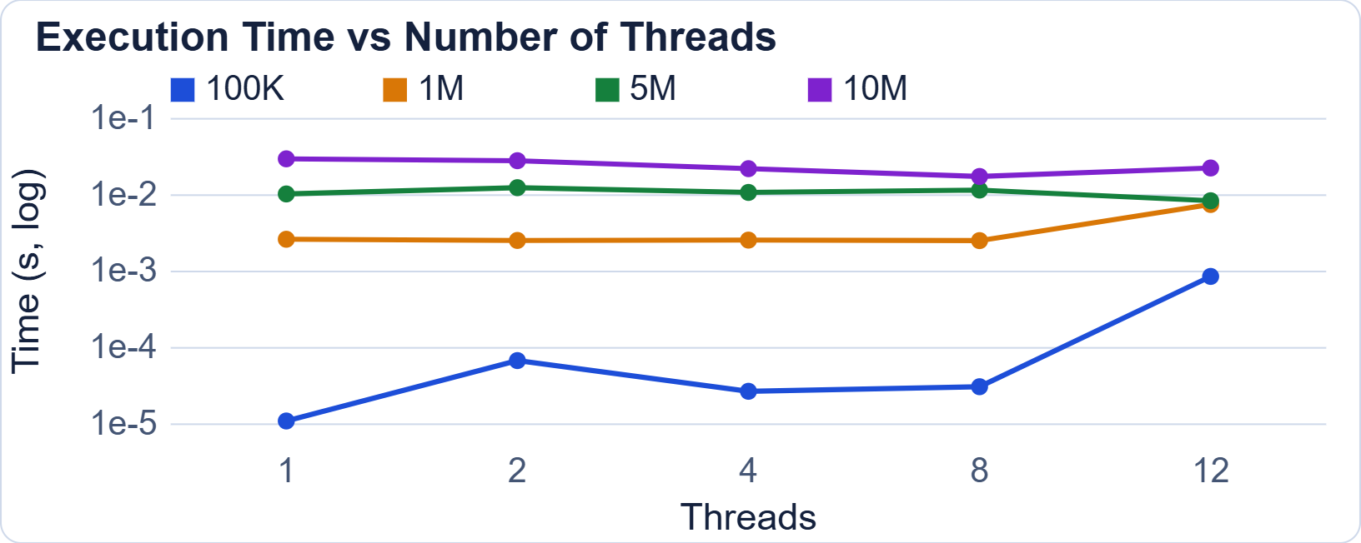
Performance Graphs
Takeaway: plotted only from the measured benchmark data above.
9/12

Slide 10
Performance Analysis
Vector size
Thread count
Small workloads: little computation
Overhead dominates (100,000 @ 12 thr: 0.19×)
Larger vectors give threads more work
More threads ≠ automatically faster
5M: best at 12 threads (2.39×)
10M: best at 8 threads (1.63×)
1M: about 0.84× at 1–8 threads
Parallel overhead
Hardware limits
Thread management, work distribution
Scheduling, synchronization
Memory access
CPU architecture, cache behavior
Memory bandwidth
OS scheduling, other running processes
Takeaway: speedup depends on workload size, not just on thread count.
10/12

Slide 11
Correctness & Final Demonstration
Verification
Live demonstration
Input | Expected
A[0]=1, B[0]=2 | C[0] = 2
A[1]=2, B[1]=3 | C[1] = 6
A[2]=3, B[2]=4 | C[2] = 12
A[3]=4, B[3]=5 | C[3] = 20
A[4]=5, B[4]=6 | C[4] = 30
Compile sequential version
Compile OpenMP version
Run with different thread counts
Run benchmark
Generate graphs
Compare performance
Sequential and OpenMP produce the same values.
Takeaway: both implementations give identical, correct results.
11/12

Slide 12
Conclusion & Team Contribution
Conclusion
Shrikar
Parallel implementation and testing
Implemented sequential vector multiplication
Implemented OpenMP parallel vector multiplication
Evaluated multiple vector sizes and thread counts
Measured execution time, speedup and efficiency
Performance depends on workload size and available resources
More threads do not always give proportional speedup
Shreya
Benchmarking and result collection
Sai Shree Ram
Performance analysis and graphs
Ankush
Sequential implementation, OpenMP integration, repository organization and documentation
Takeaway: parallel speedup is workload-dependent, not guaranteed.
12/12

